Slide 1
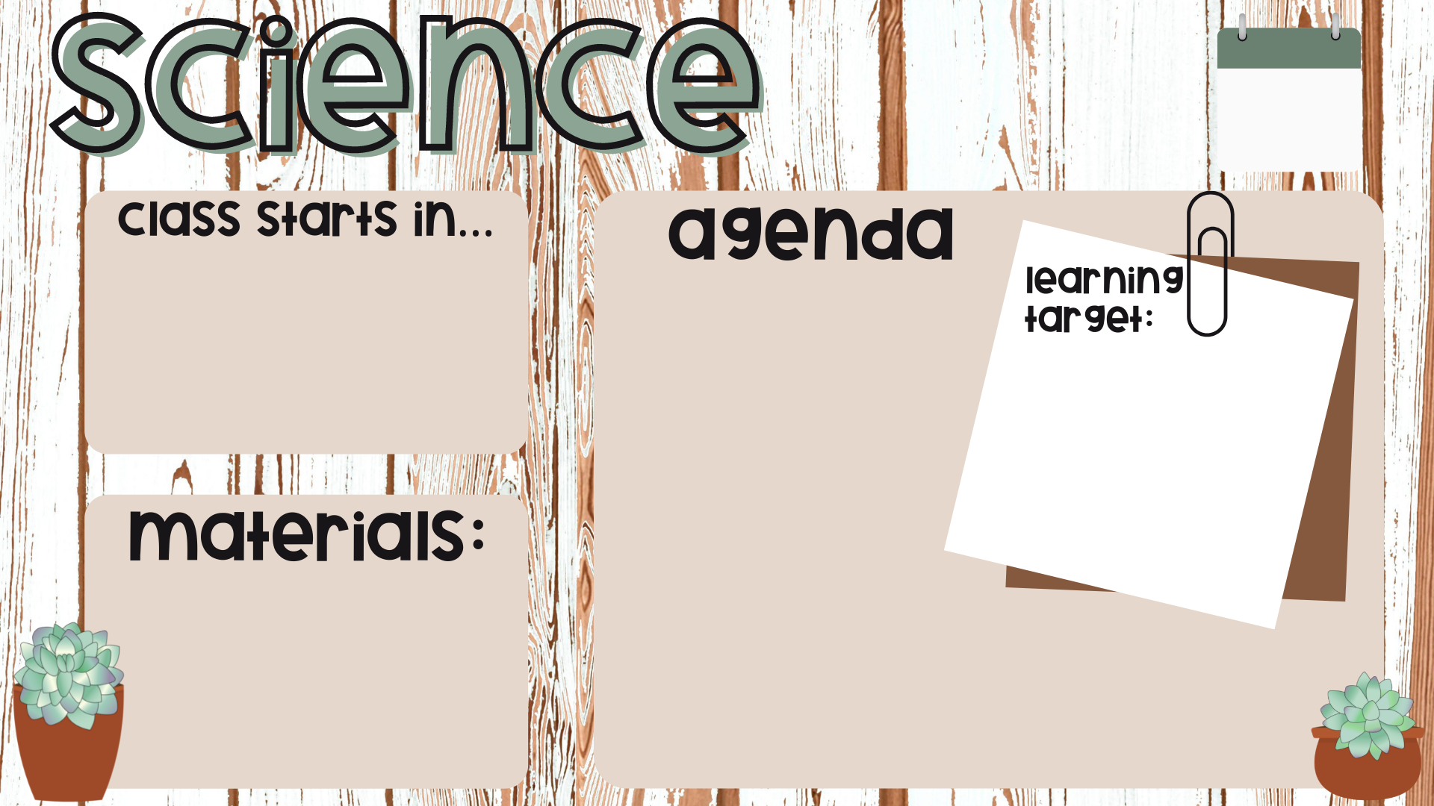
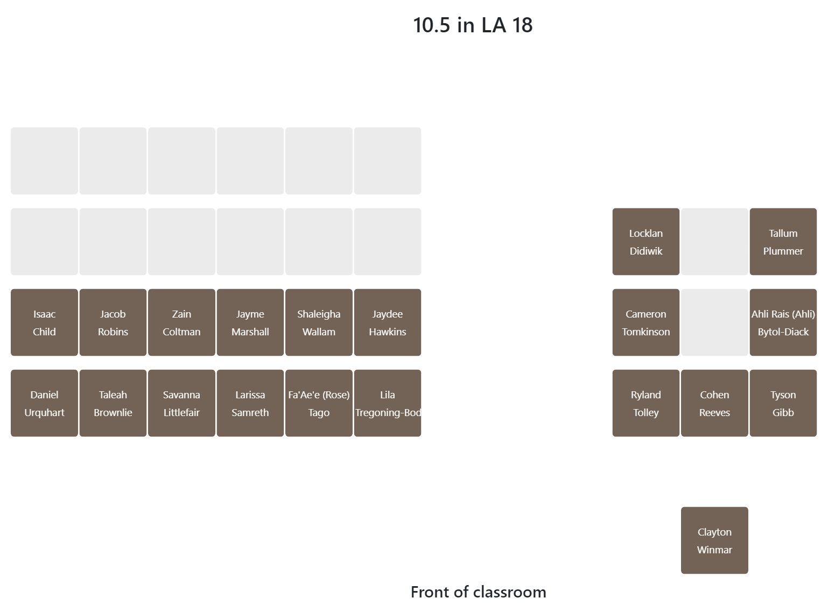

FEB
21
Mini Test Catch Up
Simple Inheritance: Explicit Instruction
Exit Ticket
Explain the difference between dominant and recessive traits
Distinguish between genotype and phenotype
Folder
Exercise Book
Pen

Slide 2
Do not delete this slide.
This slide is designed so that you can copy the prompt box you need and insert it into your slides.
This slide is hidden and will not be included when presenting your lesson.
TRACK WITH ME
VOCABULARY
1 -
HINT
Students, remember….
CHECK FOR UNDERSTANDING
READ WITH ME
TEACHER CUE
MAKE THE CONNECTION
Students, you already know….
EXTENSION
GESTURE WITH ME

Slide 3
We are learning about Simple Inheritance
TRACK WITH ME
READ WITH ME
1. Explain the difference between dominant and recessive traits
2. Distinguish between genotype and phenotype
DECLARE THE OBJECTIVE
Read the learning objective to your partner.
Notes:
Learning Objectives contain concepts (nouns, big ideas), skills (verbs, measurable behaviours) and sometimes context (restricting or targeting conditions).
●Example: Students will be able to describe the concept of density and apply it to floating and sinking.
●
Success criteria are specific measurable outcomes that if met mean that the student has met the learning objective.
Examples:
•Students will be able to compare densities of substances using mass and volume.
•Students will be able to identify whether a solid or liquid will float or sink in a liquid based on their densities.

Slide 4

Explain the difference between dominant and recessive traits
Genetic Traits
From the colour of your eyes and skin to your risk of developing a serious illness, your genes have a huge impact on your life. Genes are the units of inheritance that allow all living things, from microbes to humans, to pass on features – known as traits – to their descendants.

Slide 5
Explain the difference between dominant and recessive traits
Genetic Traits
Activity 1: A selfie of you
Take a selfie on your phone. Look closely at your features and try to identify some distinctive traits that you can also recognize in other members of your family. Label these traits as neatly as possible in your exercise book.
(If you were adopted and don't know your birth family, identify traits that you think might be genetic.)

Slide 6
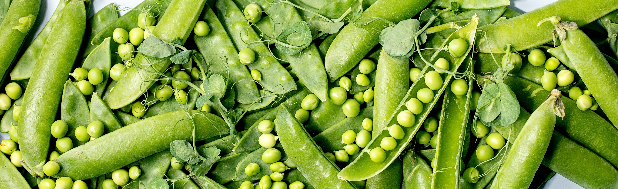
Explain the difference between dominant and recessive traits
Mendel’s discovery of simple inheritance patterns
The basic principles of genetics – the science of inheritance – were discovered in the nineteenth century by a scientist and monk called Gregor Mendel.
By carrying out a large number of experiments in the gardens of his monastery, Mendel discovered that several traits of pea plants follow simple inheritance patterns. This is when the appearance or absence of a trait is controlled by a single unit of inheritance, or gene.

Slide 7
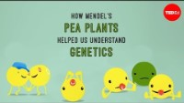
Notes:
Play video to 1:40

Slide 8

Explain the difference between dominant and recessive traits
Recall what the offspring were when Mendel bred yellow-seeded pea plants with green-seeded plants.
A. All green-seeded
B. 50% yellow-seeded and 50% green-seeded
C. 75% yellow-seeded and 25% green-seeded
D. All yellow-seeded

Slide 9
Explain the difference between dominant and recessive traits
Recall what the next generation of plants were when Mendel then bred these offspring together.
Hint: Count the "children" shown at 0:55 in the video and convert into percentages.
A. All green-seeded
B. 50% yellow-seeded and 50% green-seeded
C. 75% yellow-seeded and 25% green-seeded
D. All yellow-seeded

Slide 10

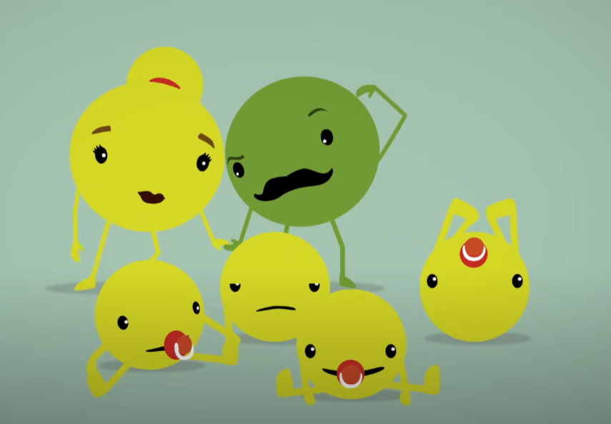
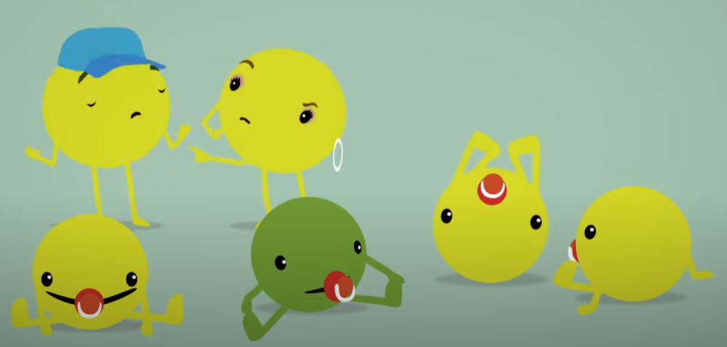
Explain the difference between dominant and recessive traits
Dominant and recessive traits
The results of Mendel's breeding experiments were very strange. Why did the pairing of a yellow-seeded pea plant with a green-seeded pea plant produce only yellow-seeded plants? And how did the trait of green seeds skip a generation and reappear in the next one?
Generation 1
Generation 2

Slide 11
Explain the difference between dominant and recessive traits
Dominant and recessive traits
Mendel reasoned that the yellow-seeded plants in the middle generation must have been carrying two different copies of the gene for seed colour: one for yellow seeds and one for green seeds. As mentioned in the video, different versions of a gene are now known as alleles.
Generation 1
Generation 2

Slide 12
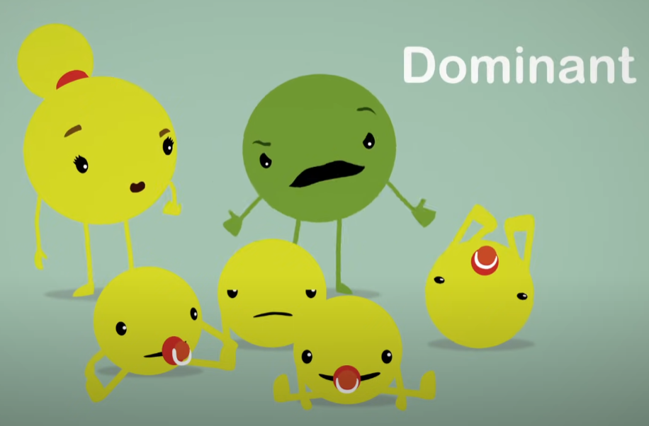
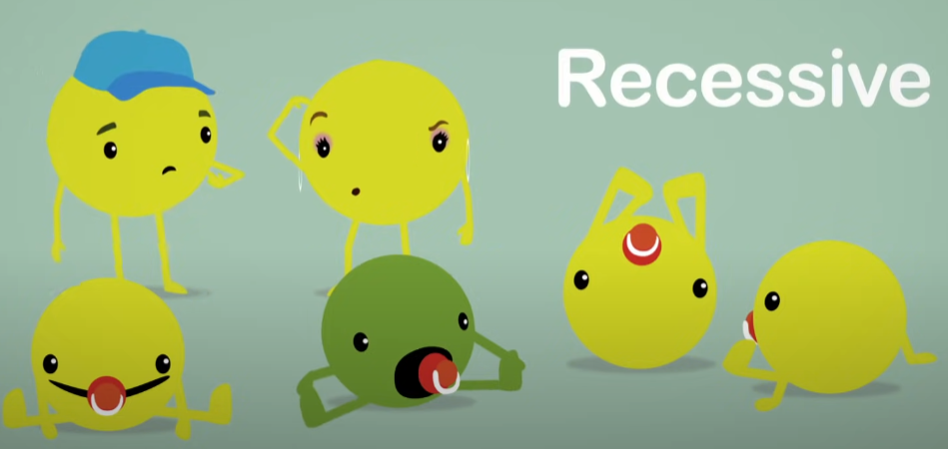
Explain the difference between dominant and recessive traits
Dominant and recessive traits
All of the plants in the middle generation must have had the allele for yellow seeds because they all "expressed" this trait in their appearance. Mendel called this the dominant trait. But the same plants must have also been carrying the allele for green seeds so that they could pass it on to some members of the next generation. Having green seeds is a recessive trait because it recedes – or goes into hiding – when the dominant allele for yellow seeds is present. It only comes out on display when a plant gets two alleles for green seeds, one from each parent.
Generation 1
Generation 2

Slide 13
Explain the difference between dominant and recessive traits
Define alleles.
A. Traits that are controlled by a single gene
B. Different versions of a gene
C. Traits that are controlled by multiple genes
D. Patterns of simple inheritance

Slide 14
Explain the difference between dominant and recessive traits
The inheritance of a recessive trait occurs only when:
A. The father contributes two alleles for the trait
B. The mother contributes two alleles for the trait
C. Each parent contributes one allele for the trait
D. Each parent contributes two alleles for the trait

Slide 15
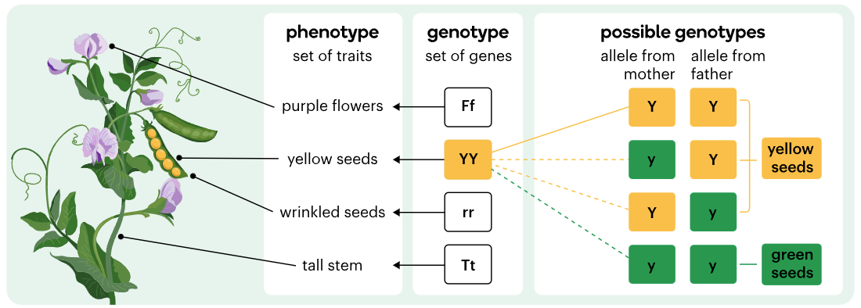
Distinguish between genotype and phenotype
Phenotype and Genotype
A particular organism's phenotype – its set of observable traits – is partly determined by its genotype – its set of genes.
The dominant allele is always symbolized by a capital letter and the recessive allele is symbolized by the lower case form of the same letter.

Slide 16
Distinguish between genotype and phenotype
Phenotype and Genotype
A genotype in which the alleles are the same is called homozygous. For example, both YY and yy are homozygous genotypes although they result in different traits. An organism with a homozygous genotype is called a homozygote.
A genotype in which the alleles are different is called heterozygous. So Yy is heterozygous and plants with this genotype are carriers of the recessive allele for green seeds but express the dominant allele for yellow seeds.

Slide 17
Distinguish between genotype and phenotype
Identify which of the following represent homozygous genotypes.
A. Bb
B. NN
C. ii
D. Rr
E. mm

Slide 18
Distinguish between genotype and phenotype
Pea plants that are heterozygous for the seed colour gene:
A. Have green seeds but carry the recessive allele for yellow seeds
B. Have yellow seeds but carry the recessive allele for green seeds
C. Have two different seed colours – yellow and green
D. Have two different alleles for seed colour
(remember yellow is dominant and green is recessive for pea seed colour)

Slide 19
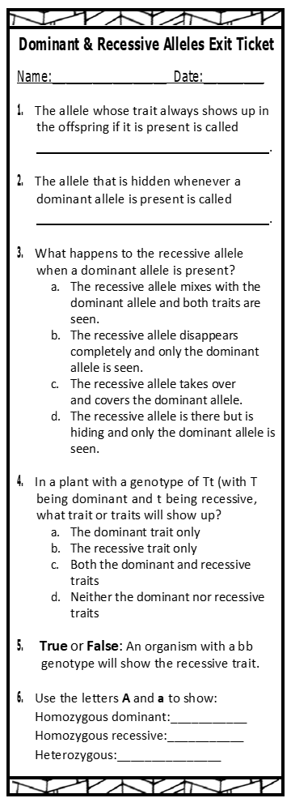

Distinguish between genotype and phenotype
Exit Ticket

Slide 20
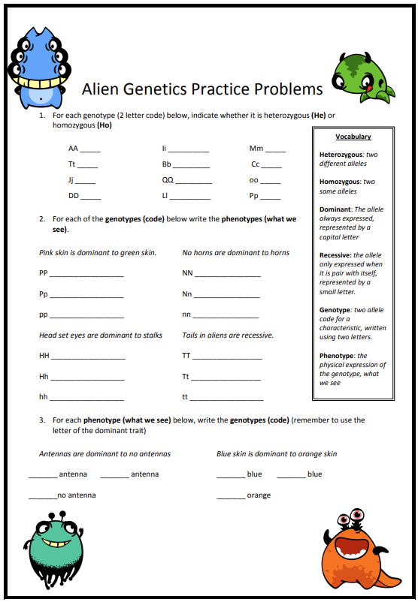
Distinguish between genotype and phenotype
@ Home Study

Slide 21
We are learning about Simple Inheritance
TRACK WITH ME
READ WITH ME
1. Explain the difference between dominant and recessive traits
2. Distinguish between genotype and phenotype
DECLARE THE OBJECTIVE
Read the learning objective to your partner.
Notes:
Learning Objectives contain concepts (nouns, big ideas), skills (verbs, measurable behaviours) and sometimes context (restricting or targeting conditions).
●Example: Students will be able to describe the concept of density and apply it to floating and sinking.
●
Success criteria are specific measurable outcomes that if met mean that the student has met the learning objective.
Examples:
•Students will be able to compare densities of substances using mass and volume.
•Students will be able to identify whether a solid or liquid will float or sink in a liquid based on their densities.

Slide 24
Notes:
Please include tasks/questions here rather than just referring to a worksheet. This will save on photocopying and facilitate sharing with other schools.
Try and build tasks/questions which escalate through Bloom’s Taxonomy. This will help with differentiation.

Slide 25
CHECK FOR UNDERSTANDING
Check Success Criteria.

